Slide 1
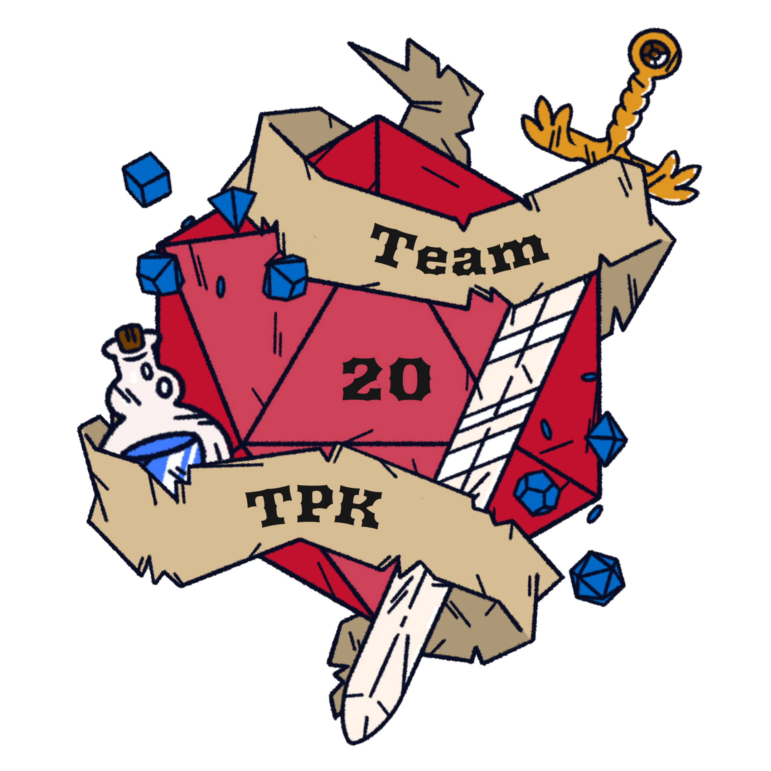






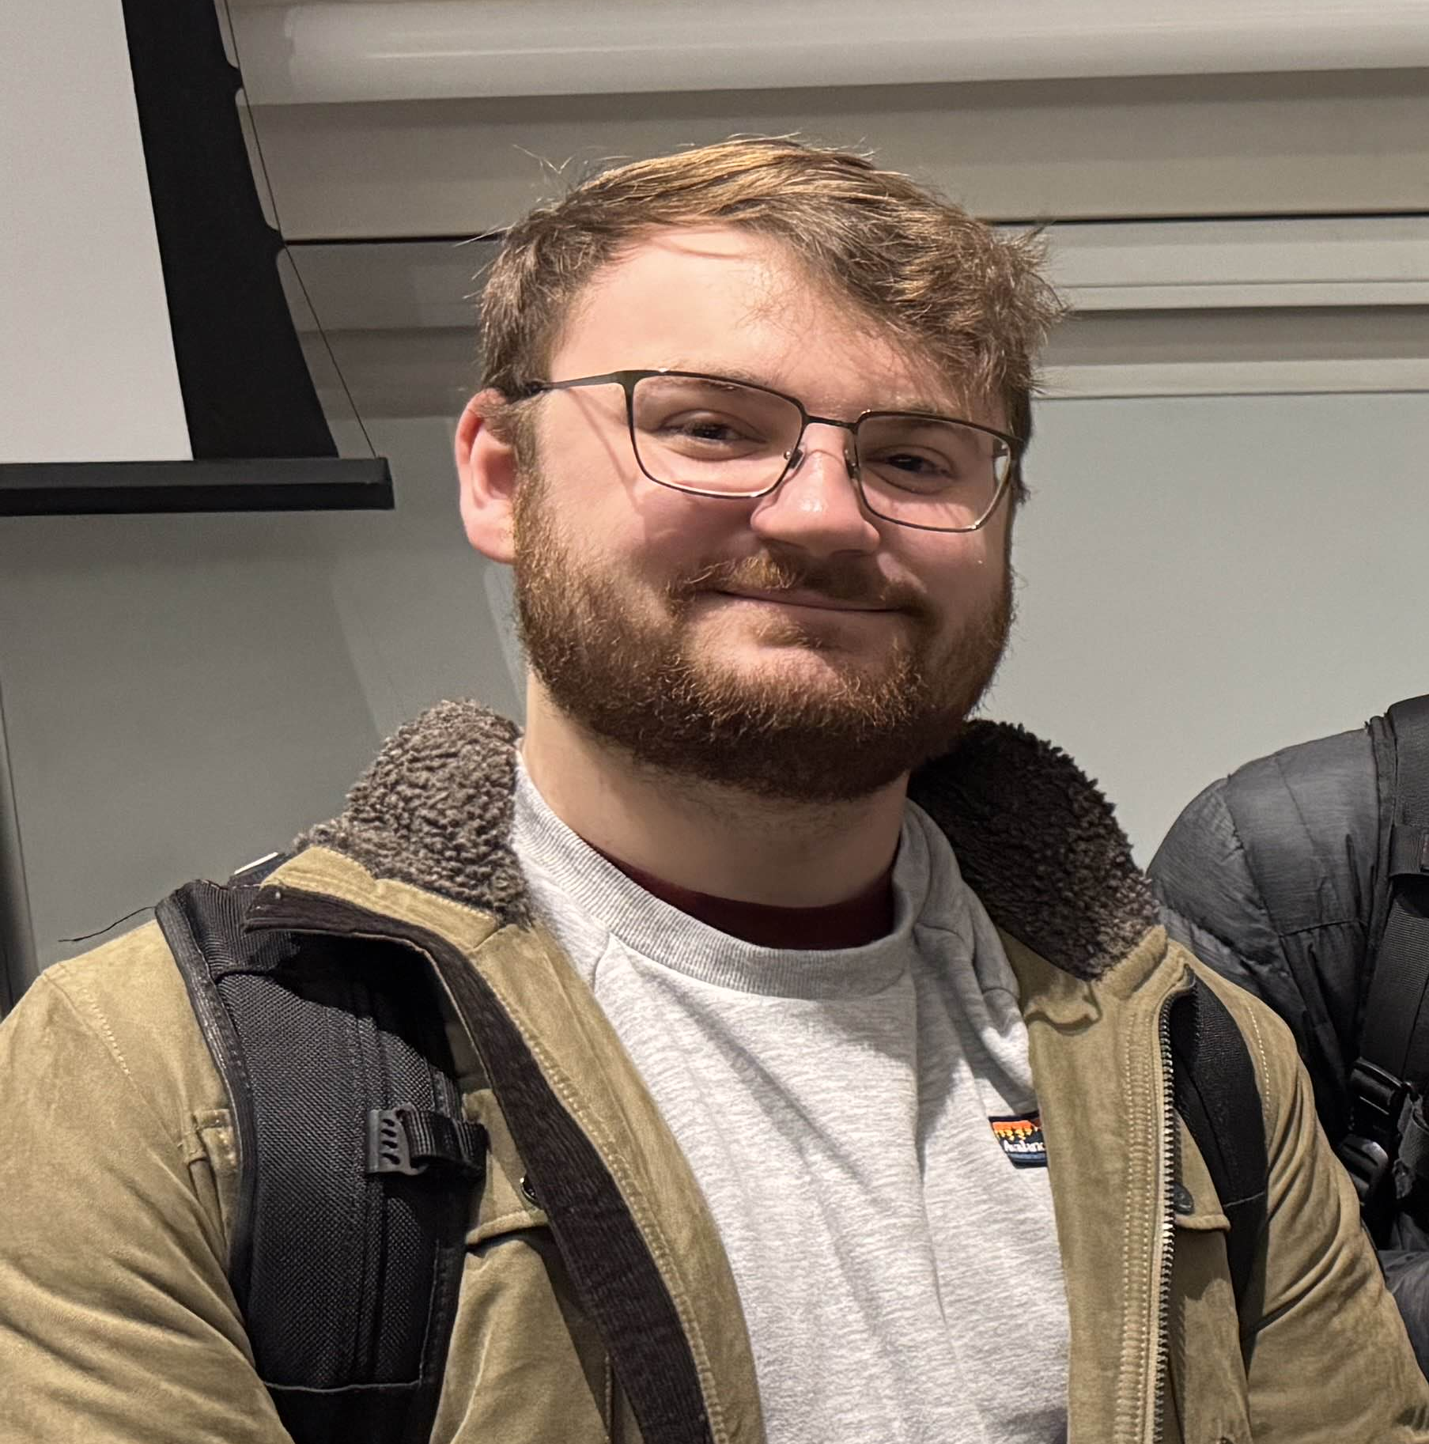


Total Party Kill: A D&D Combat Simulator
Project Abstract
Technologies
Applications
As both D&D players and game masters, we have all dealt with the difficulties of an unbalanced combat encounter. To solve this, we created a web application that allows users to implement player character sheets, design monsters, and build combat encounters that can then be ran against our combat simulator. Leveraging a multi-threaded batch processor and Monte Carlo simulation, we provide robust and precise information for game masters to balance encounters with.
Partnership with Online Tabletops: By working with virtual tabletops like D&D Beyond or Roll20, we could pull users’ character sheet and encounter data to provide accurate reports with our combat simulator.
Sports Analytics and Strategy: The technology could be repurposed to predict match outcomes based off player stats and past performances.
Defense Sector: D&D has roots in the defense industry as an accurate wartime simulator. That means our product could help predict the outcomes of real-world encounters.
Goals
Develop a user-friendly front-end website for account and character creation, combat encounter simulation, and result visualization.
Build a back-end database to store user data, encounter details, and simulation results, with full integration to the web app and combat simulator.
Create a dynamic combat simulation system using state vectors and production rules to model behavior, run Monte Carlo simulations, and output detailed results to the database.
Team Members
Accomplishments
Brandon Thompson – Computer Science
Sam Puffer – Computer Science
Nick North – Computer Science
Dr. John Gallagher – Advisor
User input for all aspects of our final design. Meaning full creativity for GM's using our website.
Variety of programmed combats showing proof of concept.
Accurate data analysis and results for complex encounters

